Slide 1
A Painterly Approach:
The (In-?)Significance of Color in Deep-Learning Image Classification
By Trevor Barrow

Slide 2
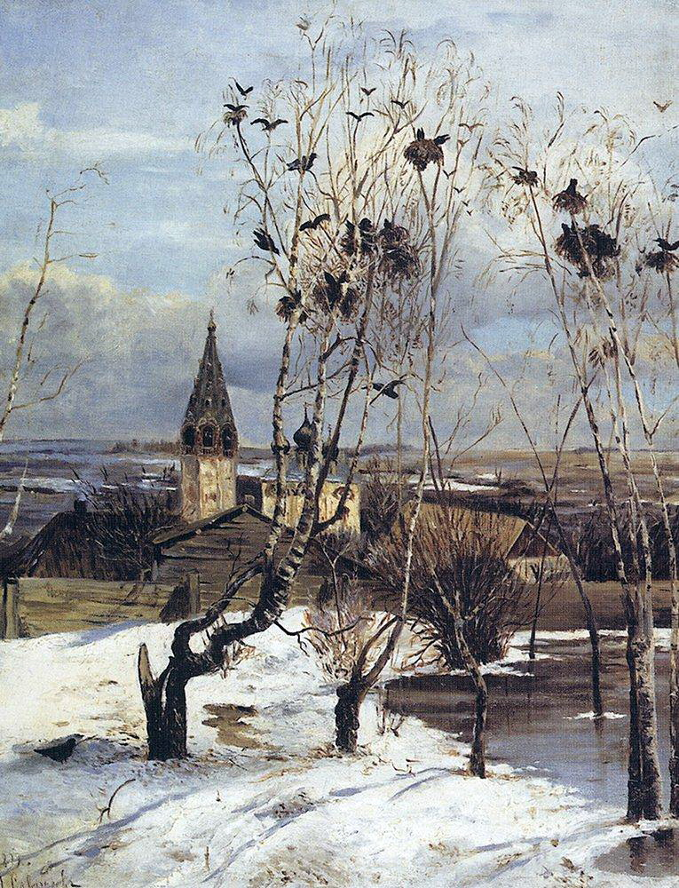
The Formation
Wanted to learn about Deep Learning
Wanted to work with image classification
Wanted a project to learn about the models and not just gaining the highest accuracy possible
Enjoy art criticism
Paintings are plentiful
The Rooks Have Come Back, Alexei Savrasov, 1871

Slide 3
Why Paintings and not Photos?
Painting styles are distinct largely by brush stroke/technique, which photos don’t have
Brush strokes have unique features such as width, distance, pressure
A painting’s style can be identified entirely through its brush strokes
Thus, paintings have certain details unique to them that photos don’t contain
Grouping by style/genre makes them easy to work with
If technique is so important in classification, then what else is important?

Slide 4
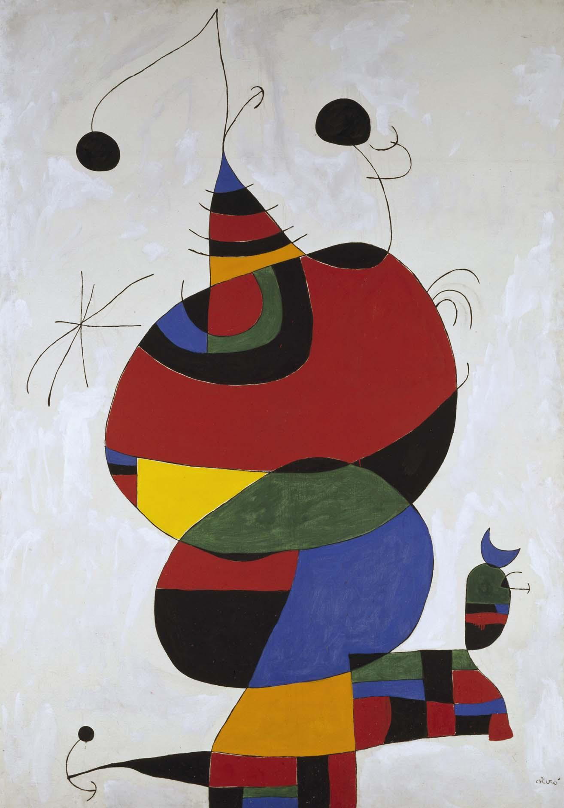
Focusing on Color
Color is also greatly important to a painting’s style
Most styles stick to certain palettes, but they overlap enough that color alone isn’t enough to information to identify a style
Most styles stick to certain palettes since styles tend to focus on certain moods
Color greatly helps in setting a mood, working off human emotion
Woman, Bird, Star, Joan Miró, 1973

Slide 5
But ‘mood’ isn’t a variable to an ML model, so is color important to it then?

Slide 6
How important is color in ML painting prediction?
|
|
V
How important is color in deep learning image classification?
Is color a confounding factor to a model?
Is color negligible?
Should models be trained on grayscale or RGB?
Do three RGB layers mean three times as much information as a single grayscale layer?

Slide 7
Investigation Methodology
Using custom-made Keras model
Three binary classification tests
Two styles, same genre
Same style, two genres
Two styles, all genres
Each test has one grayscale round and one RGB round
Each model iteration trained for 128 epochs of 325 generated samples
Model accuracy measured via 75 generated test rounds of 400 samples
Round results visualized, explored, and analyzed at end of each test
Multiple varied test allows for broader insight

Slide 8
Tools Employed
AWS SageMaker & S3
Keras
Pandas
Numpy
Matplotlib & Seaborn
Sklearn & Scipy

Slide 9
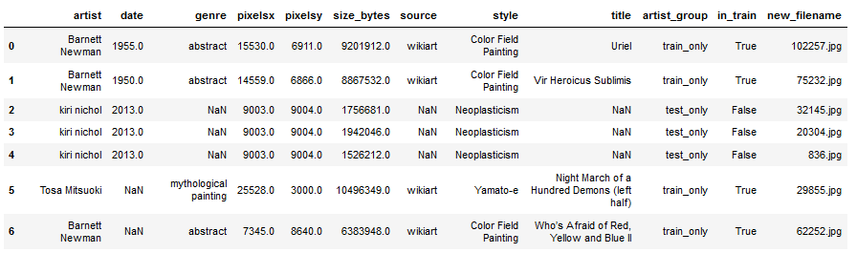
Dataset
Taken from a Kaggle competition in which, “your algorithm needs to examine two images and predict whether the two images are by the same artist or not”
Includes a CSV with data on painting (artist, style, genre, etc.) and metadata on the image files (file size, file name, train or test set) with image folders
https://www.kaggle.com/c/painter-by-numbers/data

Slide 10
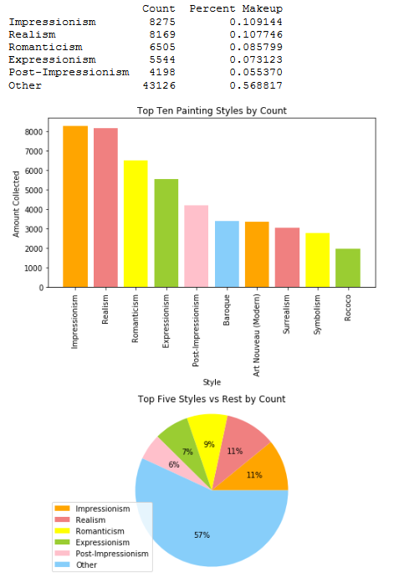
Deciding Test Parameters
Test 1: Portraits of Realism vs. Expressionism
Test 2: Portraits vs. Landscapes of Realism
Test 3: All Genres of Realism vs. Expressionism

Slide 11
Testing

Slide 12
Data Processing Steps per Model Iteration
Training set of 1:1 makeup
Test set is all relevant test samples
Load and process all images by GRY or RGB for X sets
Convert relevant classes to binary arrays for Y sets
Create data generators with X, Y sets

Slide 13
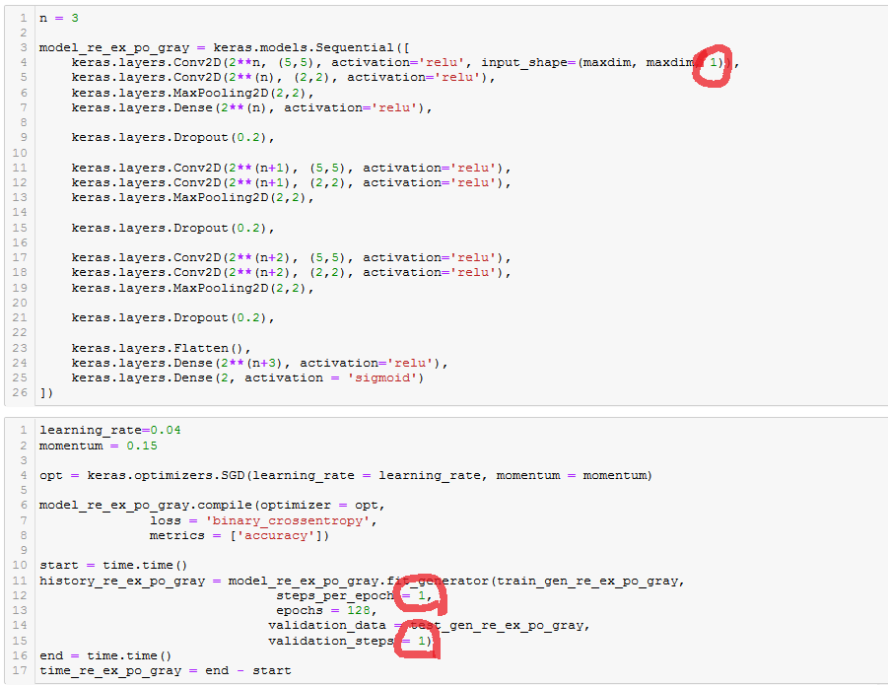
Model Sample
Using Sigmoid activation for binary classes
Using Binary Cross-Entropy as loss for binary classes
Only circled values change based on GRY or RGB

Slide 14
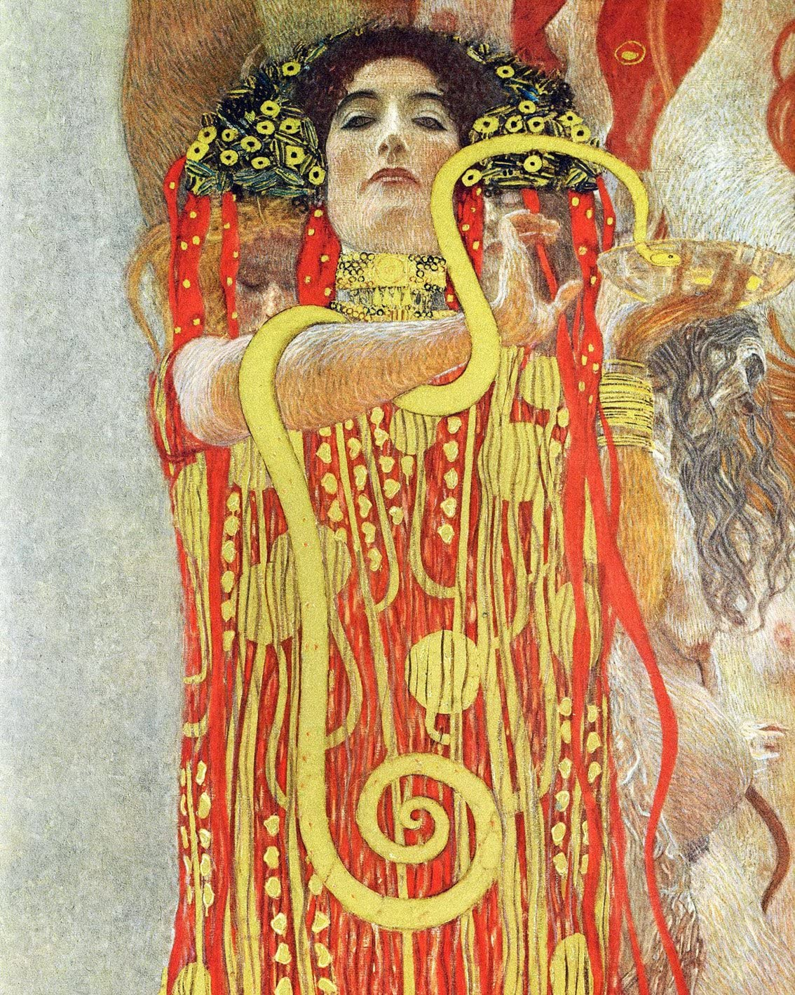
Means of Analysis
Model training accuracy and loss comparison via line plot by epoch
Averaged test confusion matrix comparison
Test accuracy histograms
Test accuracy boxplots
Descriptive statistics dataframe
P-tests for proof of (in)significance
University of Vienna Ceiling Paintings (Medicine), detail showing Hygieia, Gustav Klimt, 1907

Slide 15
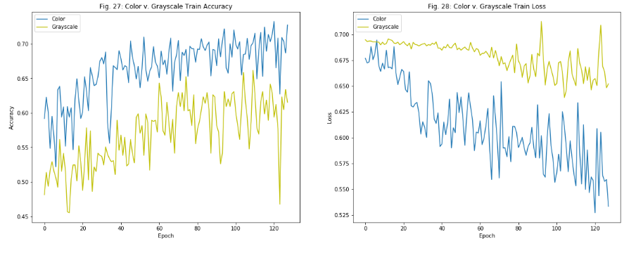
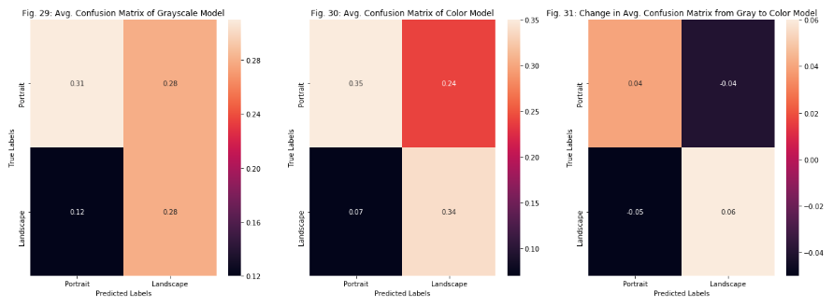
General Results #1
Acc. Training Line Plot: RGB consistently had higher accuracy, final epoch value ranging from a difference of 1 - 10%
Loss Training Line Plot: RGB consistently had lower loss, final epoch value ranging from a difference of 0.02 - 0.15
Avg. Delta Test Acc. Conf. Matrix: For all tests, there was a net positive change across the delta CM in favor of RGB. In T1 & 2, one prediction column had all positive change with the other all negative. In T3, best results with all accuracy increasing and errors decreasing.

Slide 16
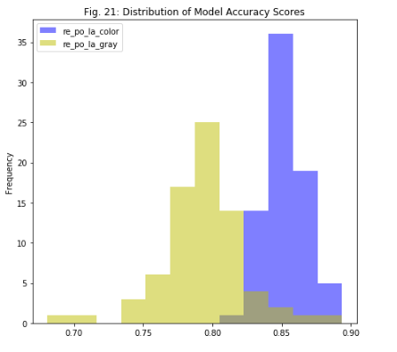
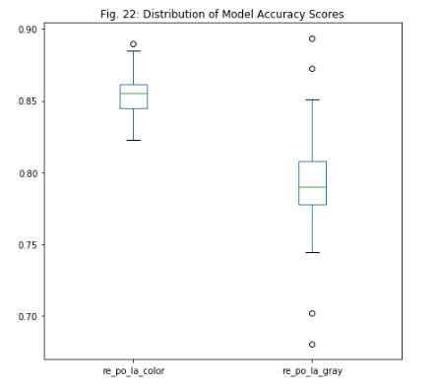
General Results #2
Test Accuracy Histogram: For all tests, RGB’s range was smaller than GRY’s by 3 - 20% and had a higher mean by 6 - 9.5%
Test Accuracy Boxplot: For all tests, RGB’s IQ range was either the same or smaller than GRY’s by up to 2% and had a higher median by 6 - 9%
P-Tests: For all tests, the P-test resulted in a p-value so small that it was essentially zero, resulting in rejecting the null hypothesis that, “There is no significant difference between the two model accuracy samples (p-value > 0.05)”

Slide 17
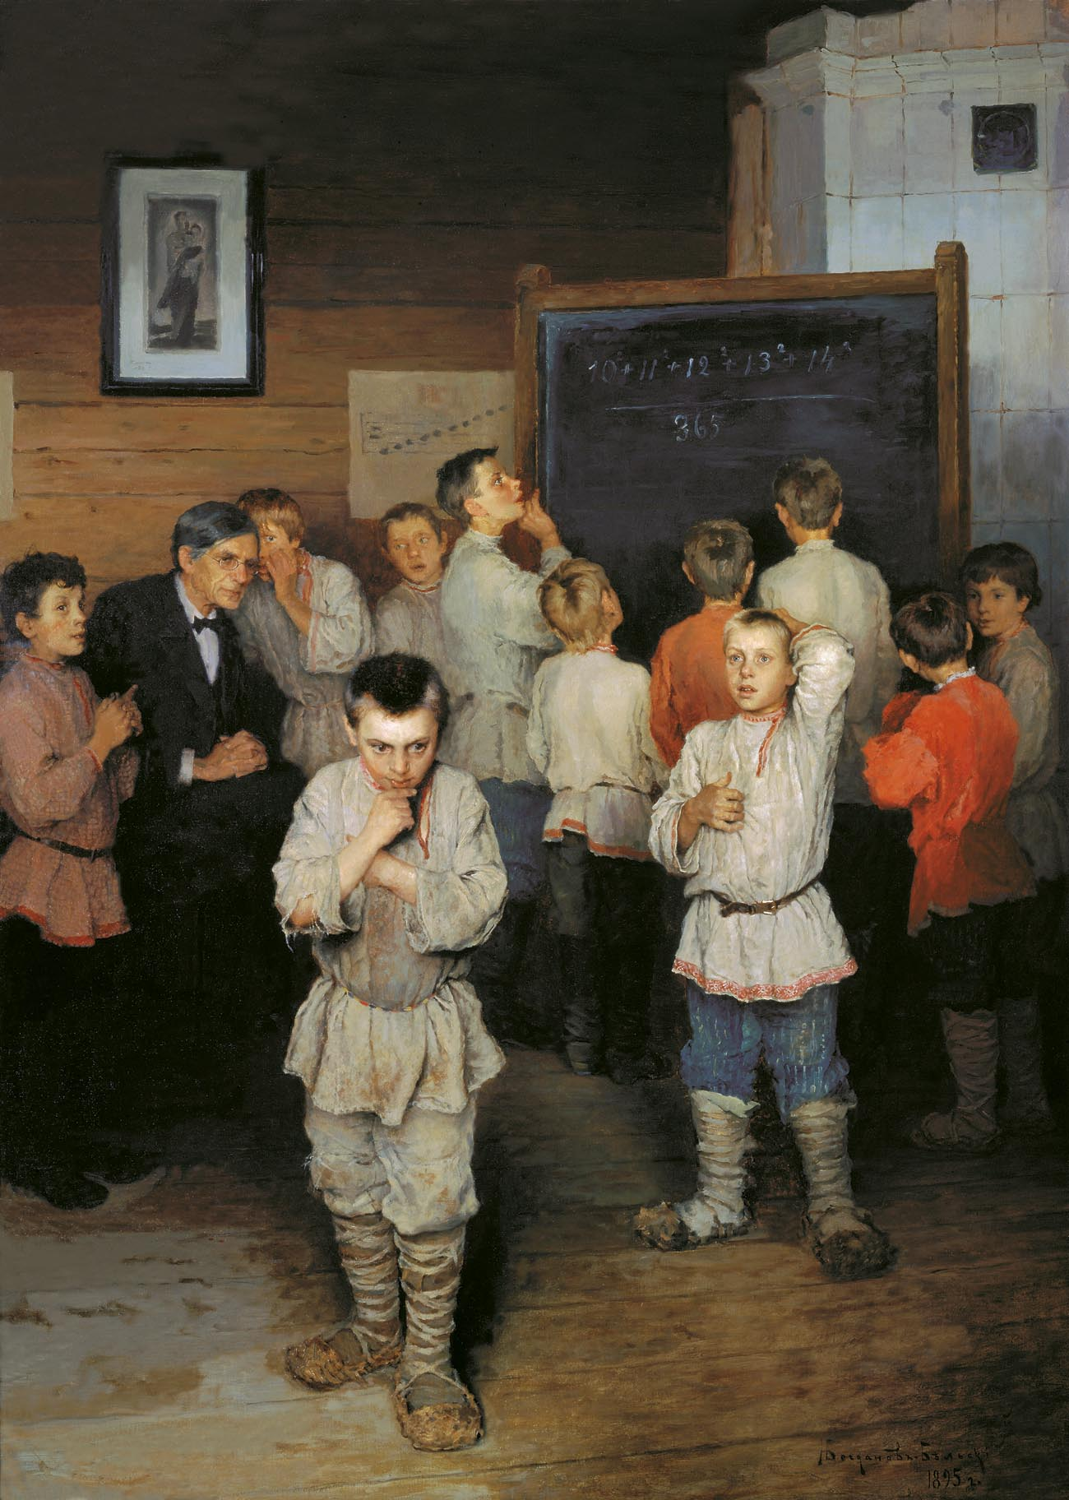
Conclusion
Case Question: How important is color in ML painting prediction?
General Question: How important is color in deep learning image classification?
Case Answer: Color is significant enough in painting prediction that all tests provided p-values that were virtually zero with the RGB model having consistently mean accuracy scores higher by at least 6%.
General Answer: RGB models can be assumed to be at least as good as GRY models, but don’t perform worse. The degree of difference between models in testing results on the same image task is seemingly negatively correlated to how focused/controlled the samples are, i.e. Δ(μRGB – μGRY) shrinks as class specificity increases.
Mental Arithmetic, Nikolay Bogdanov-Belsky, 1895

Slide 18
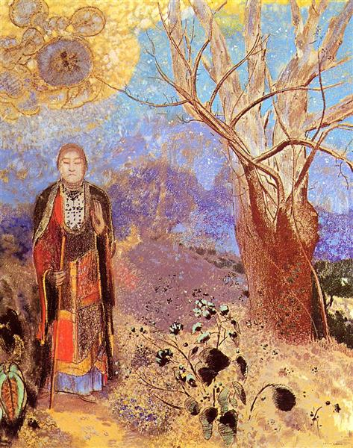
Future Additions
Try different style/genre combinations for additional case evidence
Try 3+ classes at once
Build further on model for higher accuracy for both GRY and RGB on all tests
Try different DL libraries for additional case evidence
Try other art mediums/photographs for additional general evidence
Try to maintain/increase accuracy while reducing run time per epoch
The Buddha, Odilon Redon, 1905

Slide 19
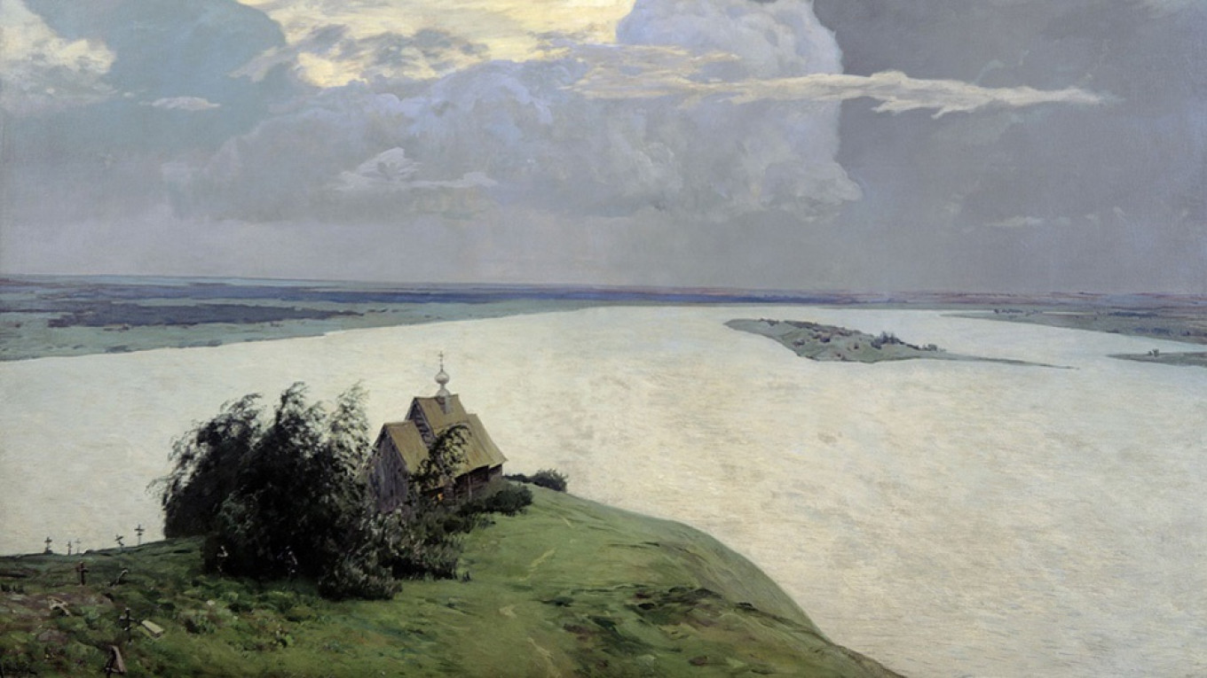
Thank you! Above Eternal Peace, Isaac Levitan, 1894

